Slide 1
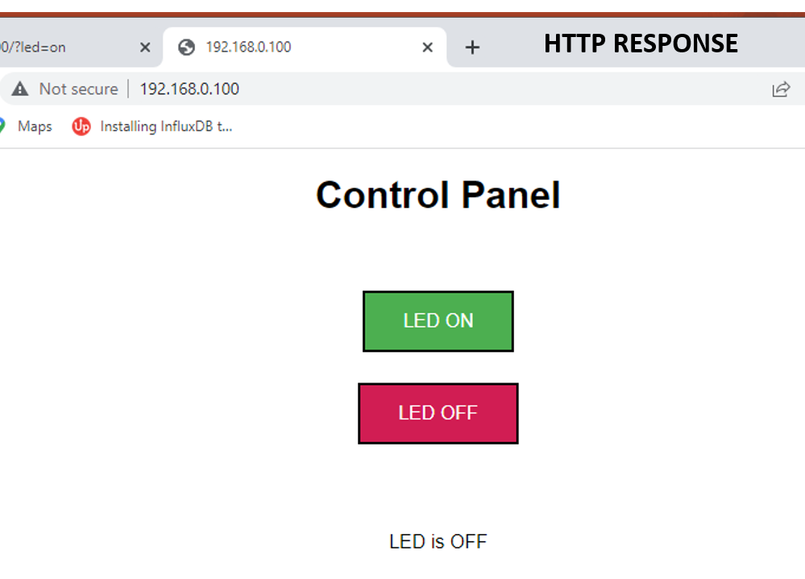
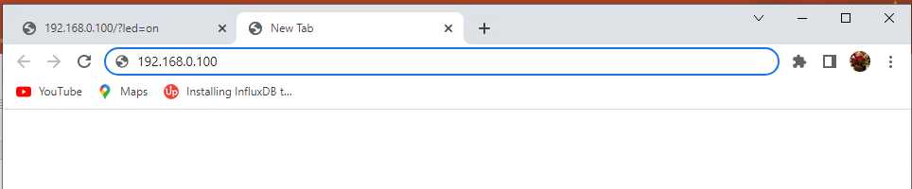
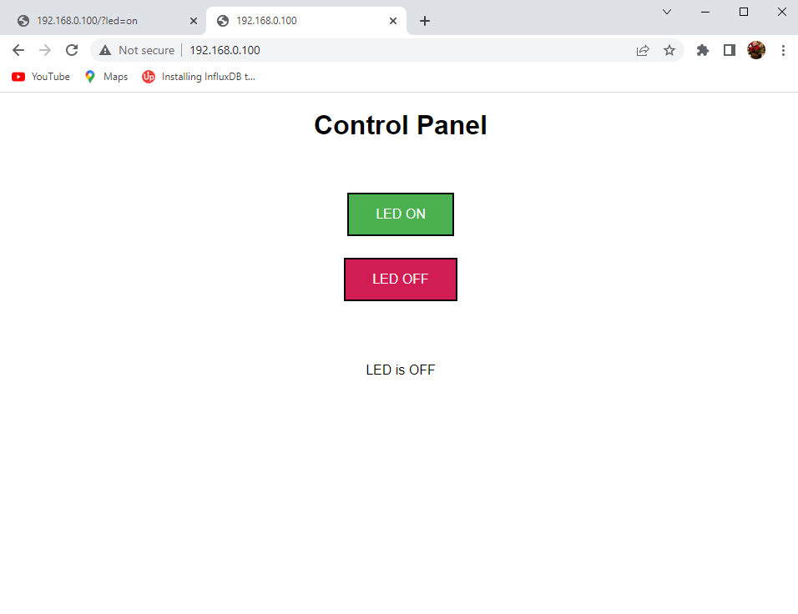
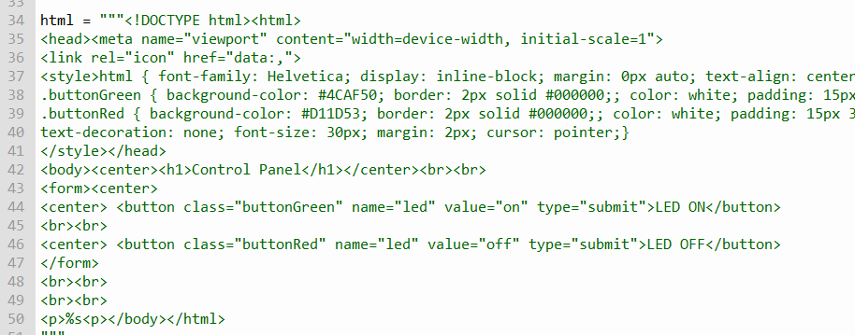

HTTP REQUEST
HTTP RESPONSE
Browser sends request to pico web server
192.168.0.100
Arrive at pico web server

Slide 2
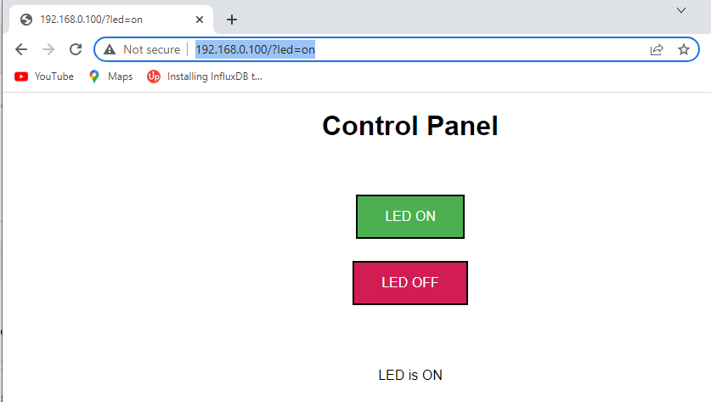
This request arrives at the Pico
When you click on this button
Browser will send new request
To the pico 192.168.0.100
This time the request carries a
payload ?led=on

Slide 3
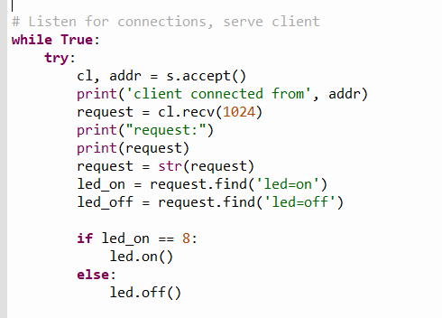
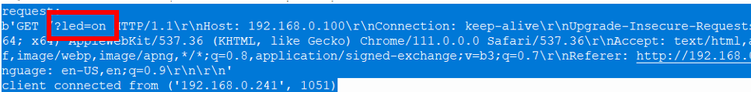
In the string request,
find whether the word led=on
is found or not
If found is it starting from
position 8 in the string

